Slide 1
Chicago Transit Authority Data Analysis
Connecting Chicago, One Ride at A Time
Submitted by:
Pranit Kotkar
Vaishnavi Shankar
Siddhi Shukla
Rewa Deshpande
Anushka Chaubal

Slide 2
GOAL
Analysis of Boarding Passengers on Transit Routes:
Analyze boarding patterns to identify peak hours, popular routes, and areas with high demand.
Insights from analysis can help CTA to optimize its transit service and improve customer satisfaction.
Factors Impacting CTA Usage:
Identify factors that influence ridership, such as weather, events, and socioeconomic changes.
This analysis can help CTA to anticipate changes in ridership and adjust service levels to meet customer demand.
Recommendations for CTA:
Based on analysis, provide recommendations to improve service quality and increase ridership.
The recommendations should focus on enhancing the overall customer experience, improving service efficiency, and addressing any identified issues or challenges.

Slide 3
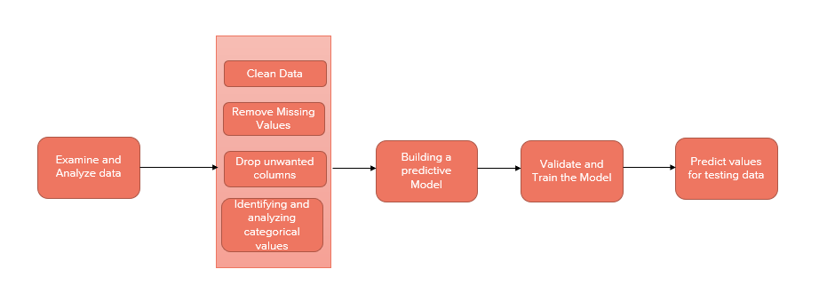
Proposed Methodology

Slide 4
Exploring Data - Data Source
CTA Bus data:
CTA-Ridership-Bus-Routes-Monthly-Day-Type-Averages
The Month_Beginning column was changed to the date format.
NA values were eliminated.
CTA L-Train data:
CTA-Ridership-L-Station-Entries-Daily-Totals
CTA-Ridership-L-Station-Entries-Monthly-Day-Type
Changed the month_beginning column to date format, specifically changed to m/d/yyyy format.
CTA Daily Ridership data:
CTA-Ridership-Daily-Boarding-Totals

Slide 5
Exploring Data - Data Source
Weather data collected from National Centers for Environmental Information:
past-weather-Chicago
Some TAVG values were missing. Calculated the TAVG value by taking the average of TMAX and TMIN.
Replaced NA values in PRCP, SNOW and SNOWD with 0.
Holidays - US Holiday Dates (2004-2021):
Holiday
Crime data collected from Crimes - 2011:
CTA-Crime
The columns X.Coordinate, Y.Coordinate, Latitude and Location were eliminated.
The Date column consisted of both the date and time of the crime. This is split into two different columns, Date and Time.
Splitting caused the dates to appear in the format MM/DD/00YY. This has been changed to MM/DD/YYYY and the column type is changed from character to date.
The Time column is changed to 24-hour format using ITime.
A new column ActiveOrInactive is added to the dataset which describes whether the crime occurred during the active or inactive hours of the day, based on the Time.

Slide 6
Exploratory Data Analytics Highlights

Slide 7
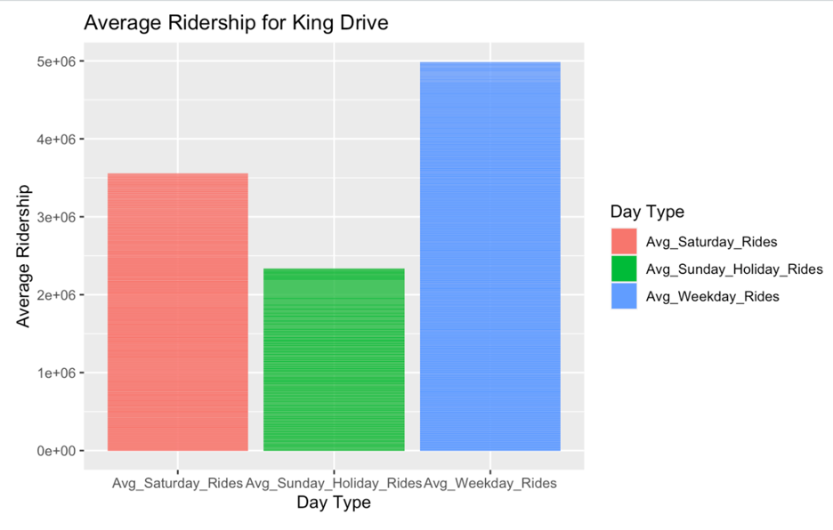
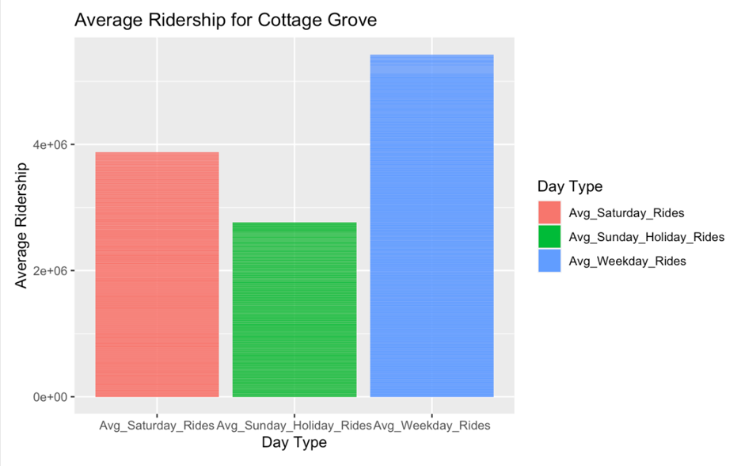
Average number of trips

Slide 8
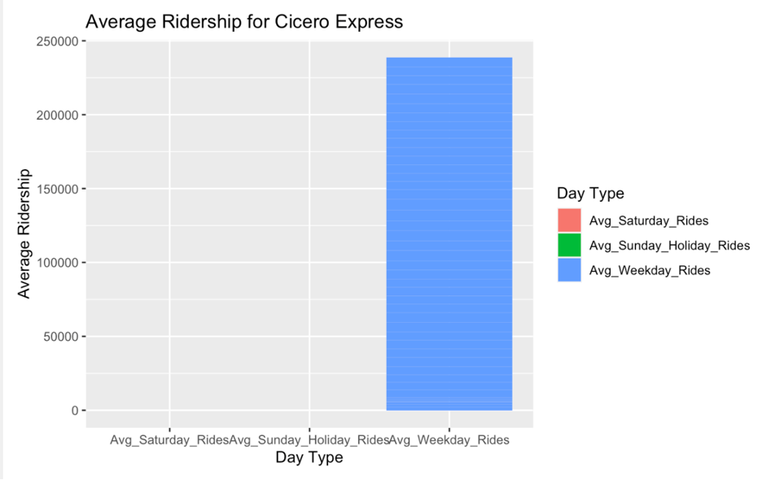
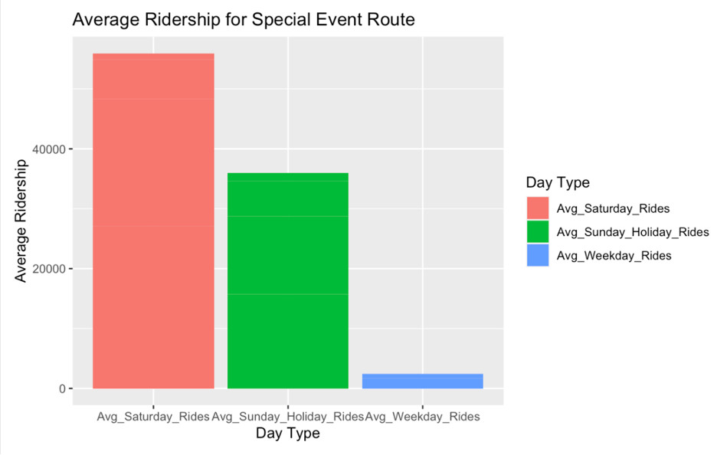
Average number of trips

Slide 9
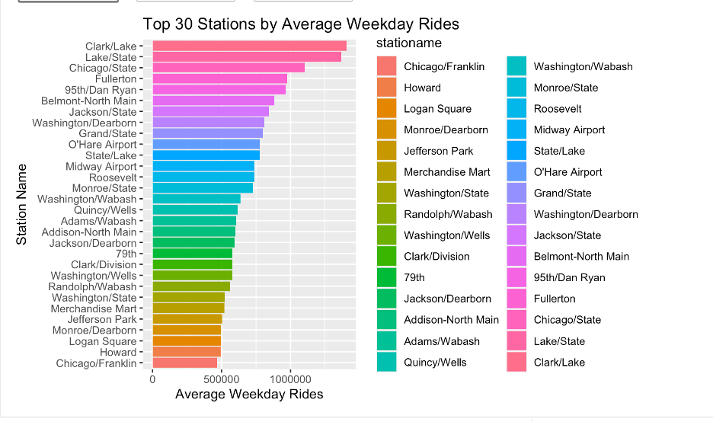
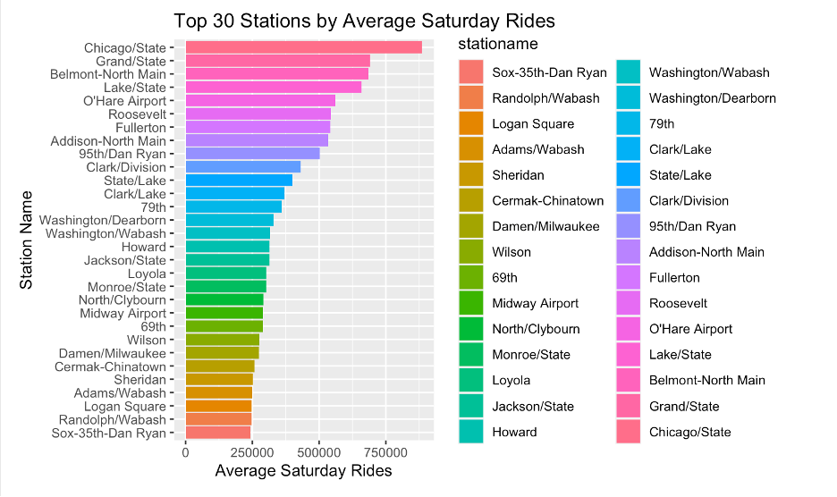
Average number of trips on Weekdays and Weekends

Slide 10
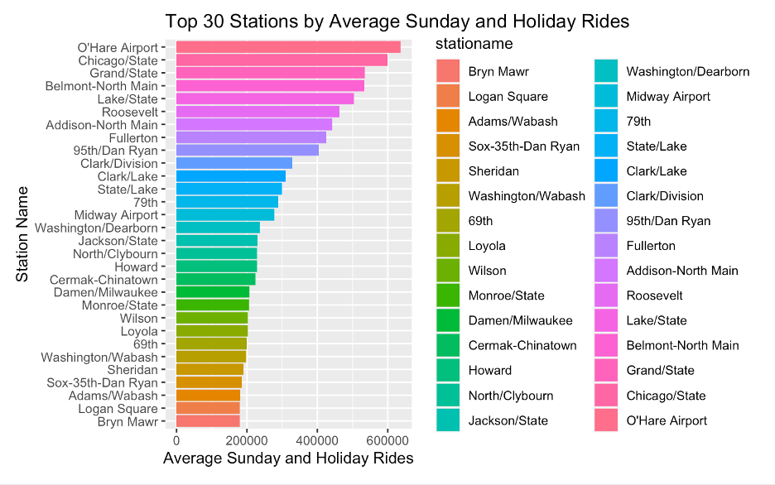
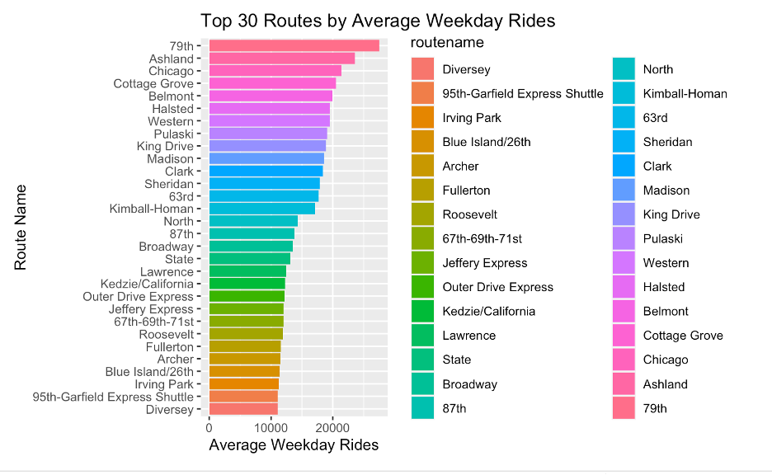
Average number of trips on Holidays and Weekdays

Slide 11
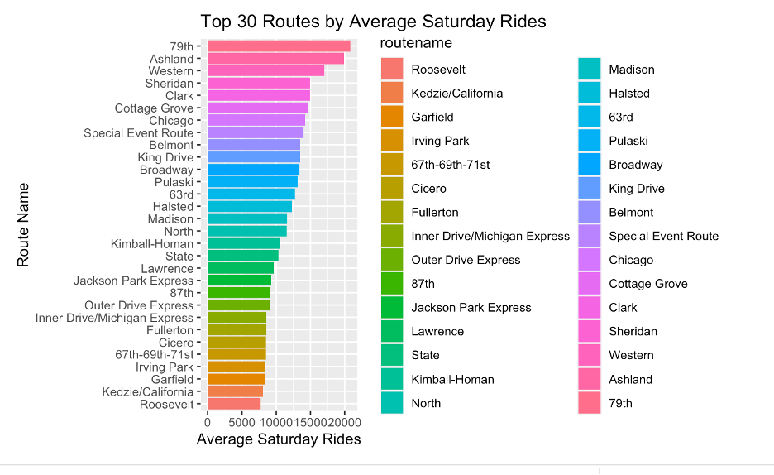
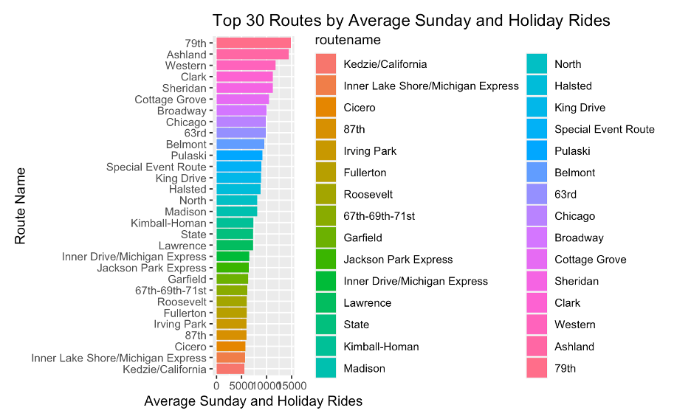
Average number of trips on Saturday and Sunday

Slide 12
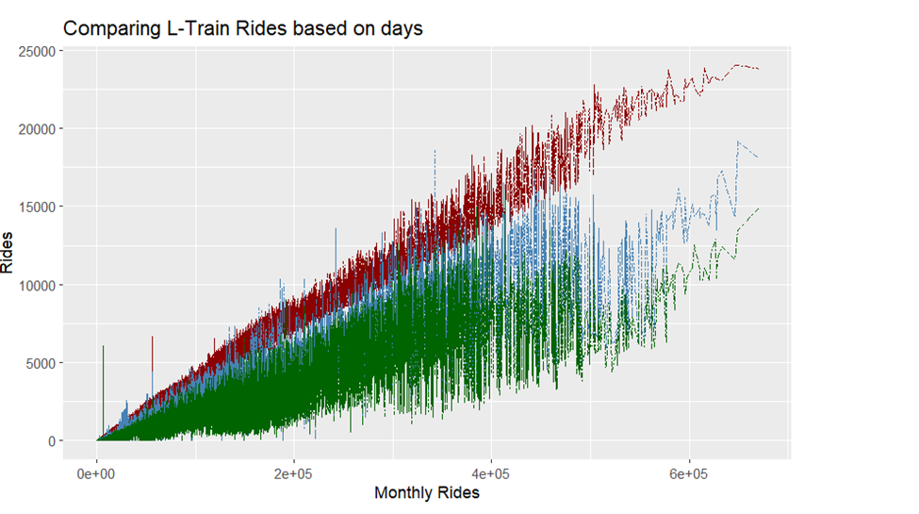
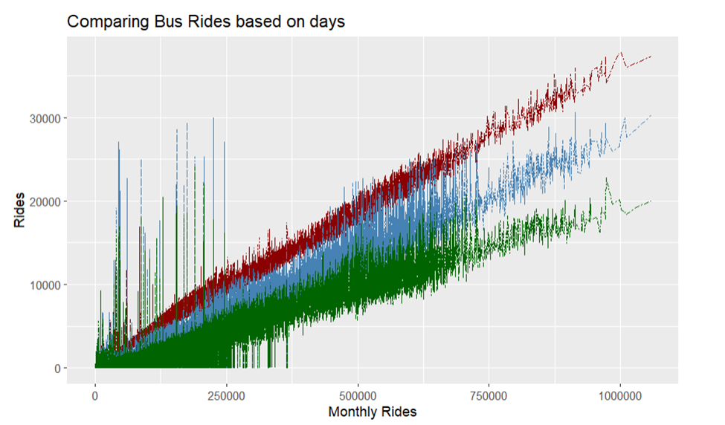
Comparing L-Train and Bus Rides

Slide 13
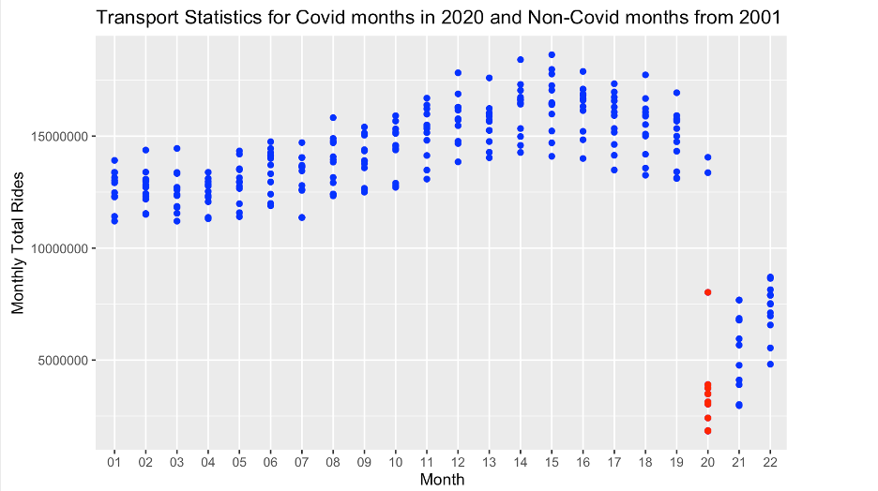
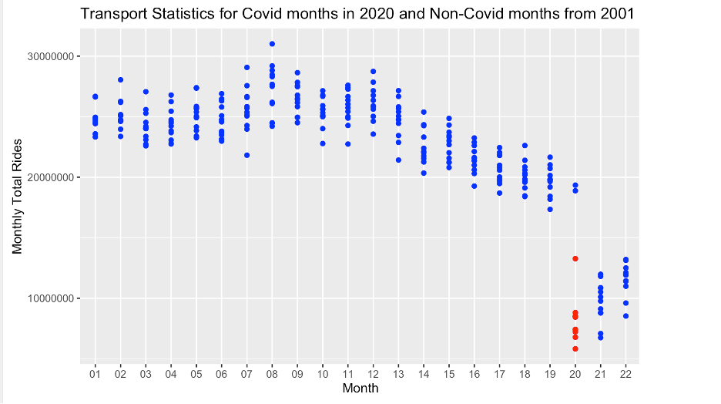
COVID Data Analysis

Slide 14
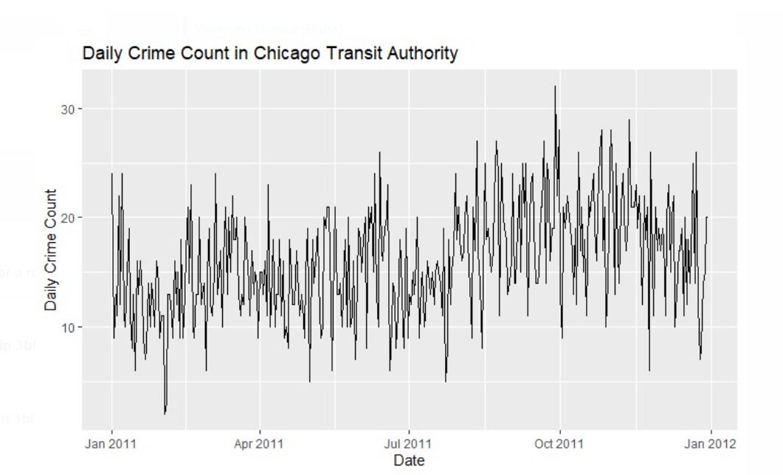
Crime Data Analysis

Slide 15
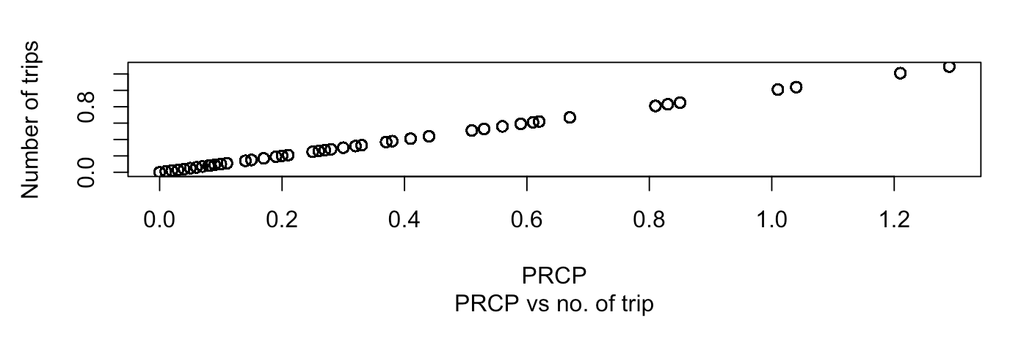
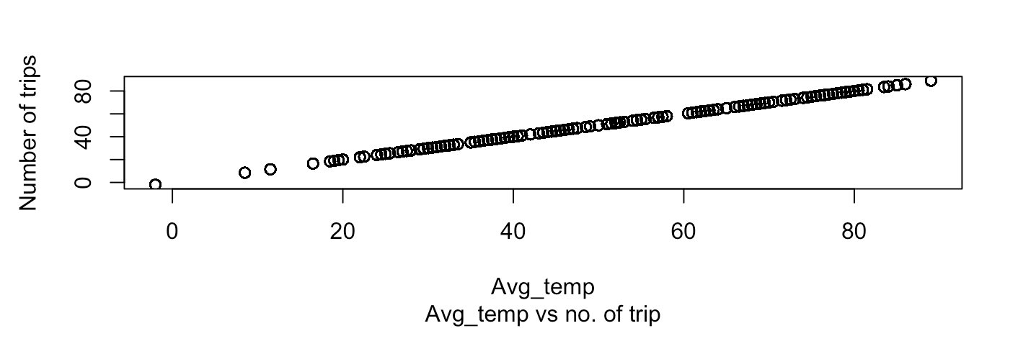
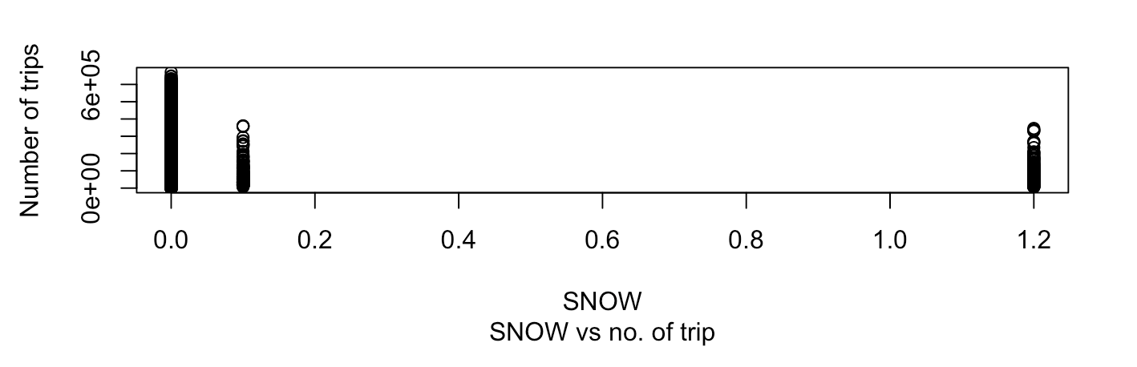
Weather Data Analysis
Precipitation versus the number of trips:
Snow versus the number of trips:
Temperature versus the number of trips:

Slide 16
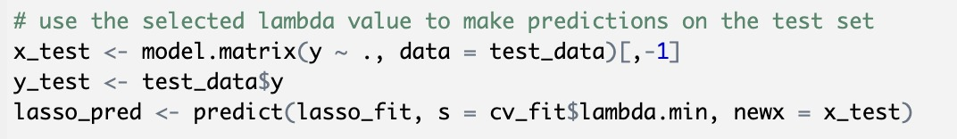
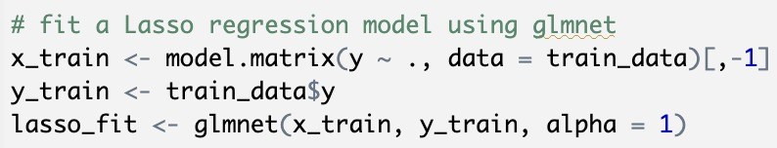
Lasso Regression to eliminate Predictors
Before modeling, using Lasso coefficients, we removed few predictors. Below are the few parameters which we have taken into consideration
Using above predictors, we have done Linear model.

Slide 17
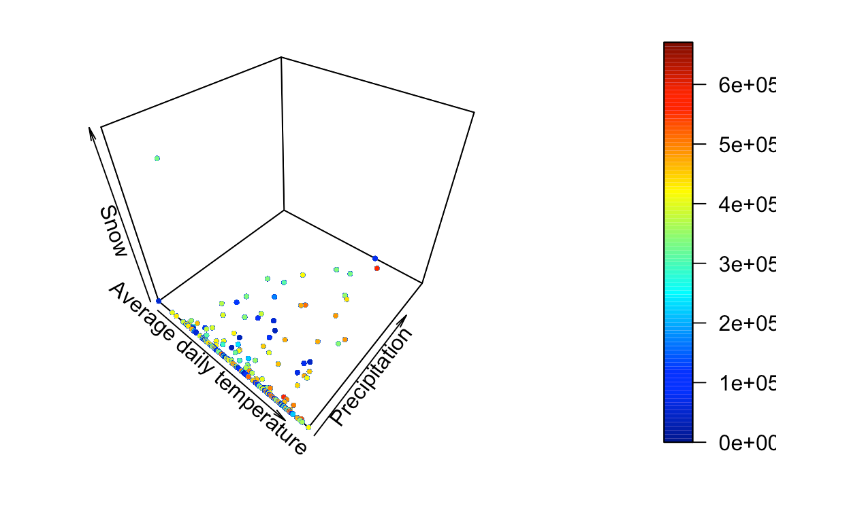
Multiple Linear Regression

Slide 18
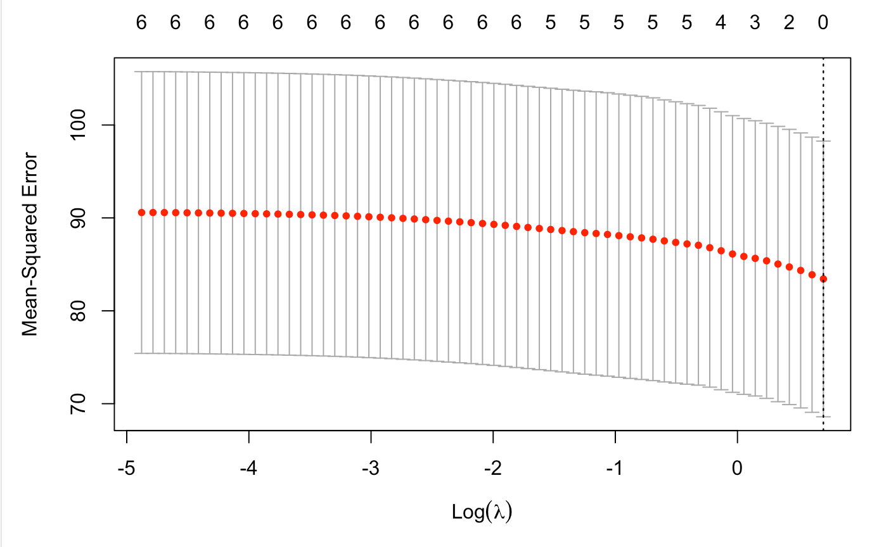
Lasso Regression

Slide 19
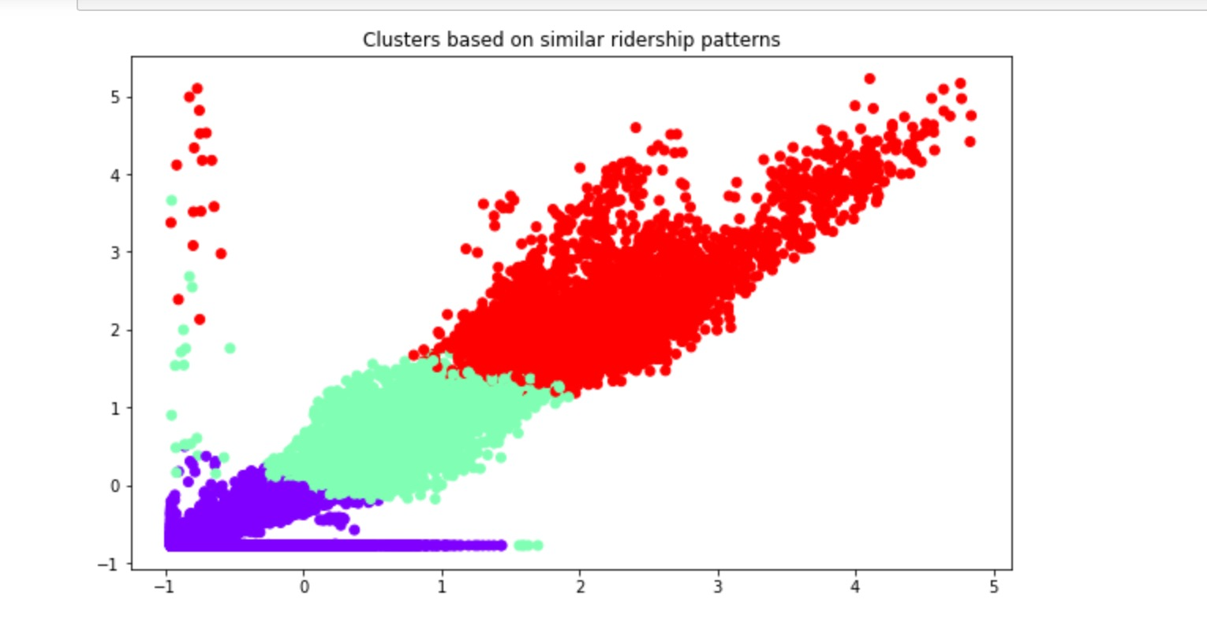
K-means Clustering

Slide 20
Model Evaluation
For Multiple Linear Regression
Residual standard error: 85990
Multiple R-squared: 0.001946
Adjusted R-squared: 0.001865
F-statistic: 24.26
For Lasso Regression
Residual standard error: 9.564569
Mean squared error: 80.50327
Multiple R-squared: 0.83
Adjusted R-squared: 0.87
F-statistic: 0.0000251788
For K-Means Clustering
Silhouette score:
0.6333605652308159
Calinski-Harabasz score:
104757.73820429464
Davies-Bouldin score:
0.5665584420999883

Slide 21
CONCLUSION
Limited dataset availability constrained project scope, hindering comprehensive analysis. However, we identified potential data sources and alternative collection solutions.
Analyze CTA crime data to provide insights on station/area safety, spotting patterns in criminal activity. Crime/ridership data combo can pinpoint hotspots, aiding resource allocation to enhance security.
COVID-19 affected CTA routes and schedules. Analyzing CTA and COVID-19 data identifies areas for cost-effective service adjustments. Linking COVID-19 dataset with CTA routes dataset was unfeasible, limiting pandemic impact analysis.
Despite the limitations, the project was able to provide valuable insights into the available data and highlight the importance of having a well-curated dataset for conducting data analysis.

Slide 22
FUTURE WORK
Create a new model with ARIMA that can handle time series data and can be used for forecasting with higher accuracy.
Include the Gender Specific dataset into the CTA dataset. This will enhance the analysis and provide deeper insights into gender-based differences and preferences. Incorporating such data can improve the accuracy and relevance of your findings.
Analyze CTA dataset by gender to adjust service levels to demand. By studying ridership by gender, identify differences on routes/times. This can optimize service and improve efficiency, but gender data was unavailable in the CTA dataset.

Slide 23
THANK YOU

